Slide 1


Git for Version Control

Slide 2
Git is a DevOps tool used for source code management. It is a free and open-source version control system used to handle small to very large projects efficiently. Git is used to tracking changes in the source code, enabling multiple developers to work together on non-linear development. Linus Torvalds created Git in 2005 for the development of the Linux kernel.

Slide 3
Before diving deep, let’s explain a scenario before Git:
- Developers used to submit their codes to the central server without having copies of their own
- Any changes made to the source code were unknown to the other developers
- There was no communication between any of the developers

Slide 4
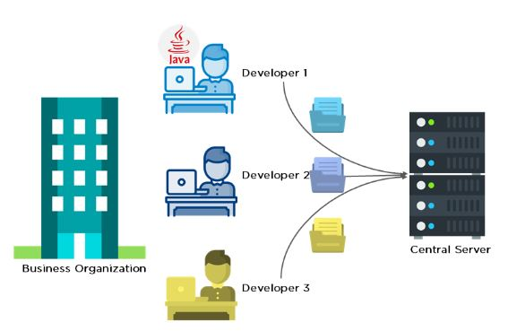

Slide 5
Now let’s look at the scenario after Git:
- Every developer has an entire copy of the code on their local systems
- Any changes made to the source code can be tracked by others
- There is regular communication between the developers

Slide 6
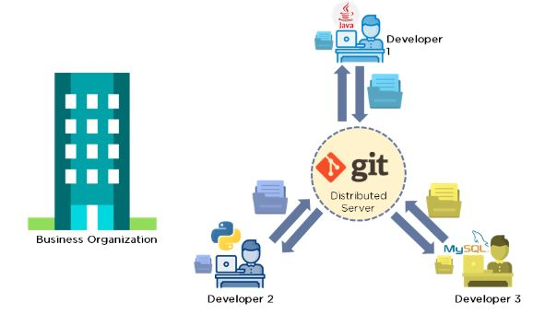

Slide 7
What is Git in simple words?
Git is a version control system used for tracking changes in computer files. It is generally used for source code management in software development.
- Git is used to tracking changes in the source code
- The distributed version control tool is used for source code management
- It allows multiple developers to work together
- It supports non-linear development through its thousands of parallel branches

Slide 8
Features of Git
Tracks history
Free and open source
Supports non-linear development
Creates backups
Scalable
Supports collaboration
Branching is easier
Distributed development

Slide 9
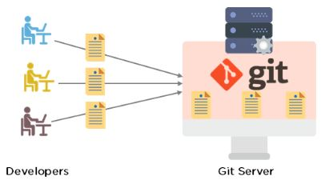

Slide 10
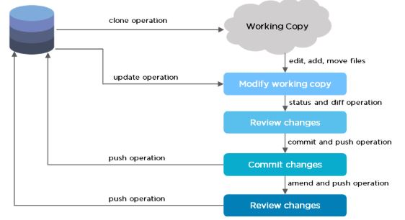
Git Workflow

Slide 11
The Git workflow is divided into three states:
Working directory - Modify files in your working directory
Staging area (Index) - Stage the files and add snapshots of them to your staging area
Git directory (Repository) - Perform a commit that stores the snapshots permanently to your Git directory. Checkout any existing version, make changes, stage them and commit.

Slide 12
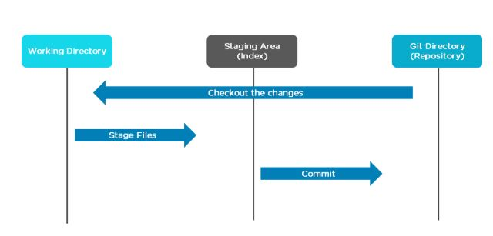

Slide 13
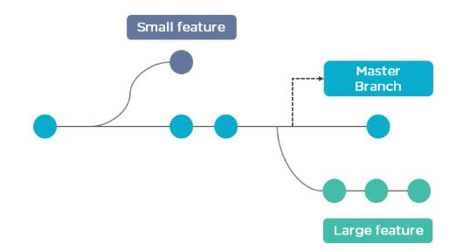
Branch in Git
Branch in Git is used to keep your changes until they are ready. You can do your work on a branch while the main branch (master) remains stable. After you are done with your work, you can merge it with the main branch(master).

Slide 14
The above diagram shows there is a master branch. There are two separate branches called “small feature” and “large feature.” Once you are finished working with the two separate branches, you can merge them and create a master branch.

Slide 15
Commands in Git
- Create Repositories
git init
- Make Changes
add
commit
status
- Parallel Development
branch
merge
rebase
- Sync Repositories
push
pull
add origin

